Slide 1
ReQWIRE: Reasoning About Reversible Quantum Circuits
Robert Rand, Jennifer Paykin, Dong-Ho Lee & Steve Zdancewic
Quantum Physics and Logic, 2018

Slide 2
Two Questions
How do we safely manage ancillae?
How do we write verified reversible circuits?

Slide 3




A reversible “AND”
$$x$$
$$x$$
$$y$$
$$y$$
$$q$$
$$q⊕(x∧y)$$

Slide 4









$$x$$
$$x$$
$$y$$
$$y$$
$$0$$
$$x∧y$$
$$0$$
$$z$$
$$z$$
$$q$$
$$q⊕(\left(x∧y\right)∧z)$$

Slide 5
What’s In An Assertion?
assert(x = 0)
// fail if x <> 0
assert0 q
// measure q and then fail if q // wasn’t originally 0???

Slide 6
Trust me
“It is the programmer’s responsibility to ensure that only correct assertions are made.”
Green et al. 2013 (Quipper)
“On actual hardware, where we are constrained by physics, we of course cannot perform such assertions without measurements… There the Assert and AssertProb functions simply return ().”
Svore et al. 2018 (Q#)

Slide 7
QWIRE
A functional quantum circuit language
Embedded in the Coq proof assistant
Equipped with a denotational semantics
Now with ancillae!
Notes:
Introduce tool as solution to problem

Slide 8
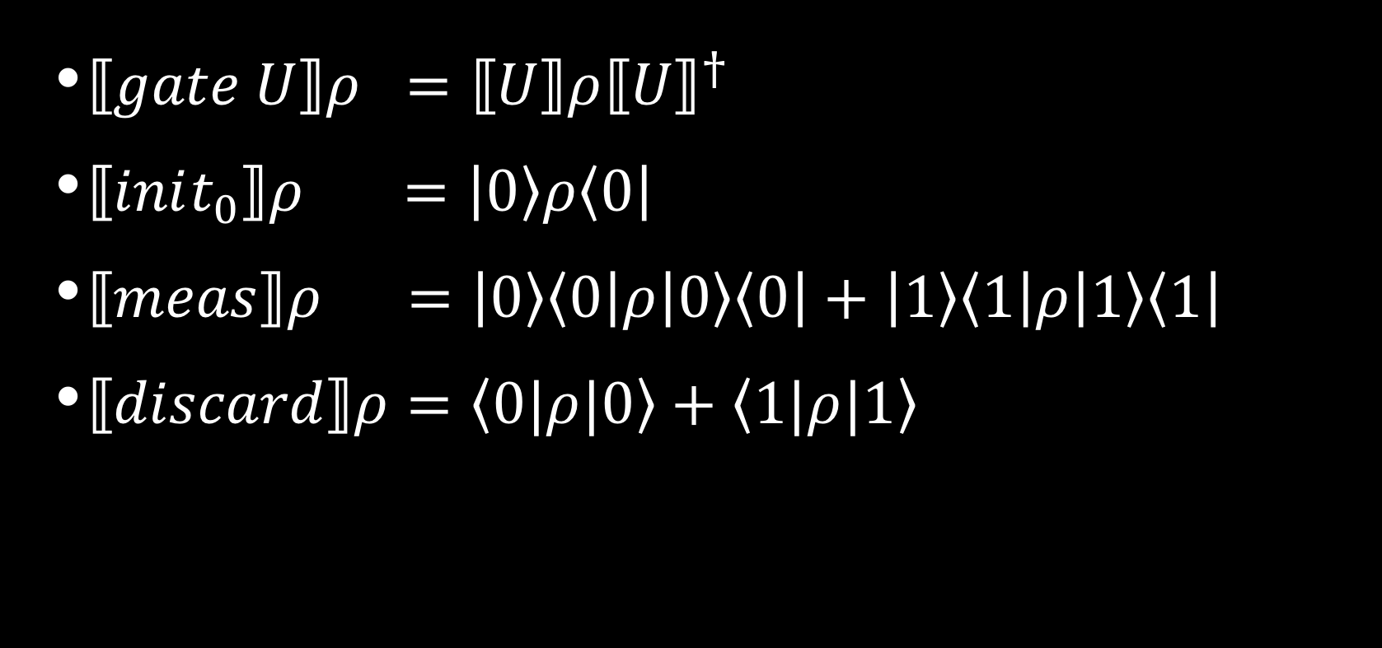
Denotational Semantics
$⟦gate U⟧ρ =⟦U⟧ρ{⟦U⟧}^{†}$
$⟦init_{0}⟧ρ =\left|\left.0\right\rangle ρ\left\langle 0\right.\right|$
$⟦meas⟧ρ =\left|\left.0\right\rangle \left\langle 0\right.\right|ρ\left|\left.0\right\rangle \left\langle 0\right.\right|+\left|\left.1\right\rangle \left\langle 1\right.\right|ρ\left|\left.1\right\rangle \left\langle 1\right.\right|$
$⟦discard⟧ρ=\left\langle 0\right.|ρ|\left.0\right\rangle +\left\langle 1\right.|ρ|\left.1\right\rangle$

Slide 9
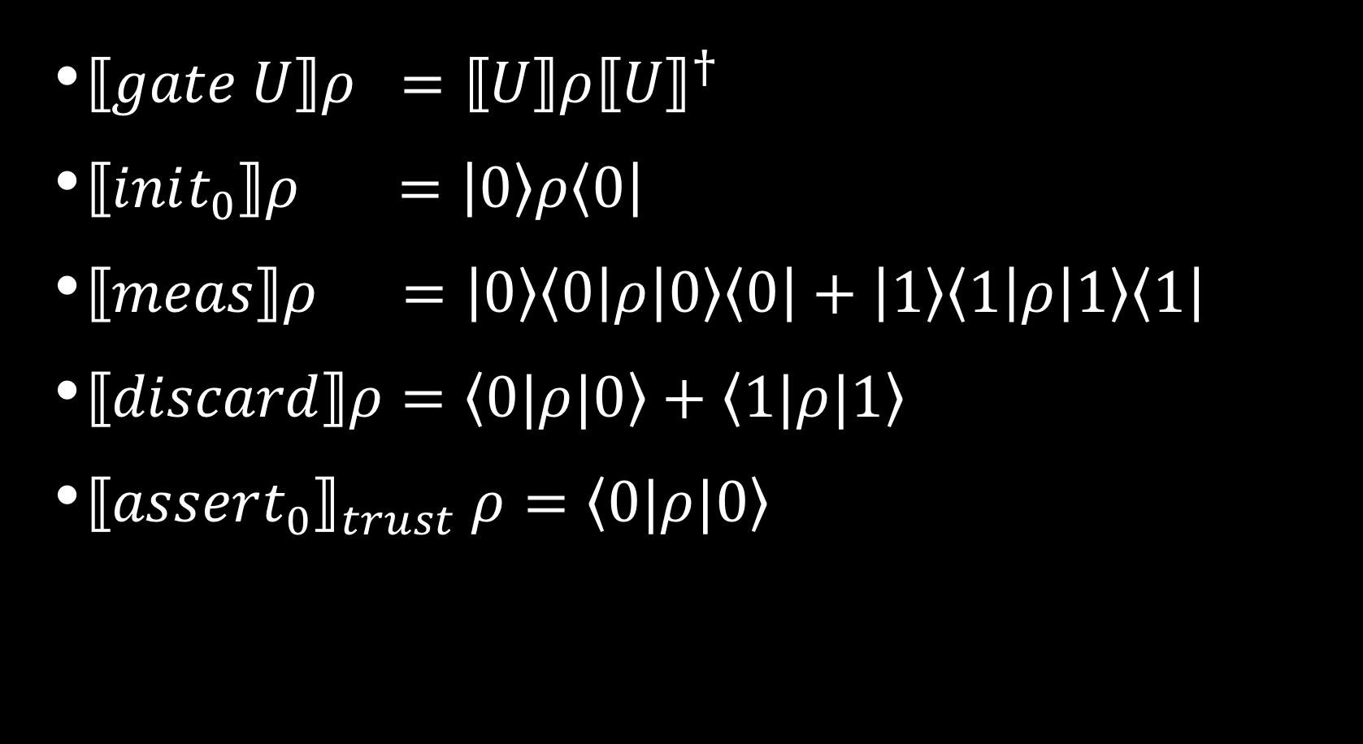
A trusting Denotational Semantics
$⟦gate U⟧ρ =⟦U⟧ρ{⟦U⟧}^{†}$
$⟦init_{0}⟧ρ =\left|\left.0\right\rangle ρ\left\langle 0\right.\right|$
$⟦meas⟧ρ =\left|\left.0\right\rangle \left\langle 0\right.\right|ρ\left|\left.0\right\rangle \left\langle 0\right.\right|+\left|\left.1\right\rangle \left\langle 1\right.\right|ρ\left|\left.1\right\rangle \left\langle 1\right.\right|$
$⟦discard⟧ρ=\left\langle 0\right.|ρ|\left.0\right\rangle +\left\langle 1\right.|ρ|\left.1\right\rangle$
${⟦assert_{0}⟧}_{trust} ρ=\left\langle 0\right.|ρ|\left.0\right\rangle$
Notes:
Slow down!

Slide 10
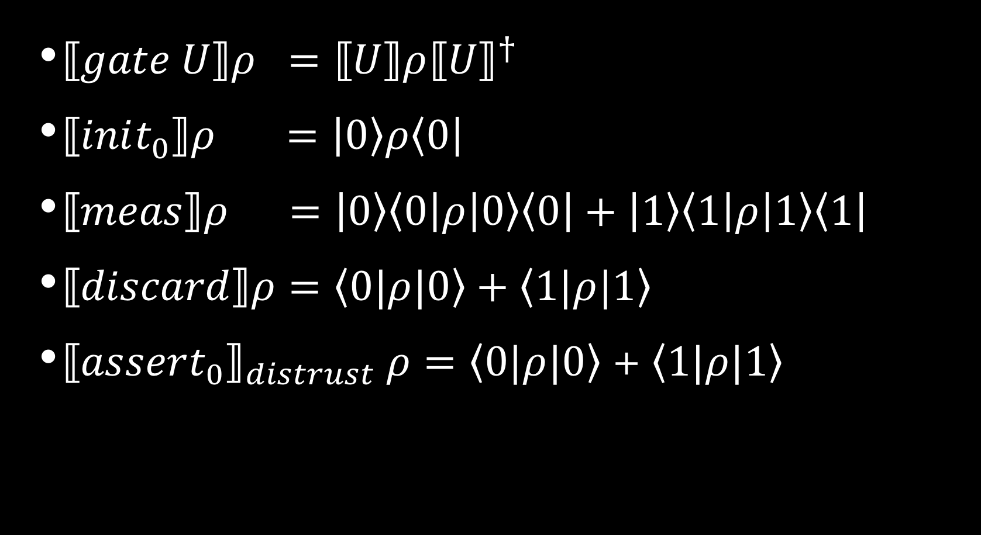
Suspicious Denotational Semantics
$⟦gate U⟧ρ =⟦U⟧ρ{⟦U⟧}^{†}$
$⟦init_{0}⟧ρ =\left|\left.0\right\rangle ρ\left\langle 0\right.\right|$
$⟦meas⟧ρ =\left|\left.0\right\rangle \left\langle 0\right.\right|ρ\left|\left.0\right\rangle \left\langle 0\right.\right|+\left|\left.1\right\rangle \left\langle 1\right.\right|ρ\left|\left.1\right\rangle \left\langle 1\right.\right|$
$⟦discard⟧ρ=\left\langle 0\right.|ρ|\left.0\right\rangle +\left\langle 1\right.|ρ|\left.1\right\rangle$
${⟦assert_{0}⟧}_{distrust} ρ=\left\langle 0\right.|ρ|\left.0\right\rangle$ + $\left\langle 1\right.|ρ|\left.1\right\rangle$

Slide 11




notionS of safety
Syntactic notions
Local semantic notions
$$0$$
$$0$$
$$0$$
$$0$$
$$0$$
C
C
Notes:
Animate!

Slide 12
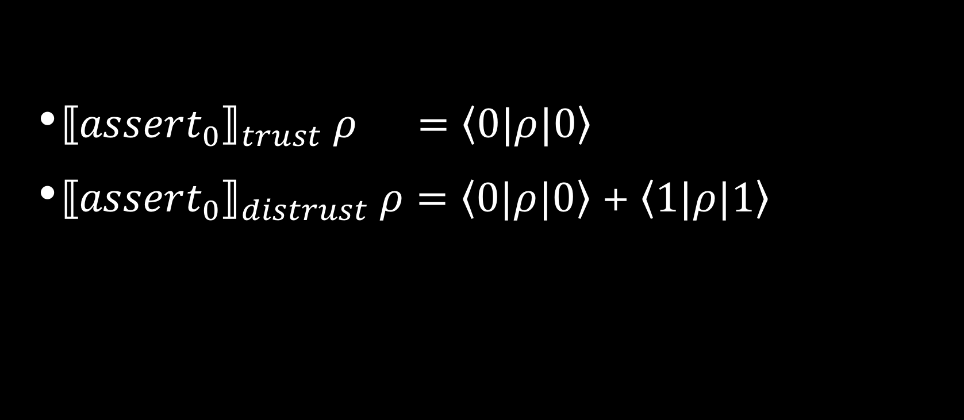
But wait
${⟦assert_{0}⟧}_{trust} ρ =\left\langle 0\right.|ρ|\left.0\right\rangle$
${⟦assert_{0}⟧}_{distrust} ρ=\left\langle 0\right.|ρ|\left.0\right\rangle$ + $\left\langle 1\right.|ρ|\left.1\right\rangle$

Slide 13

Semantic Safety
$${⟦c⟧}_{trust}= {⟦c⟧}_{distrust}$$

Slide 14
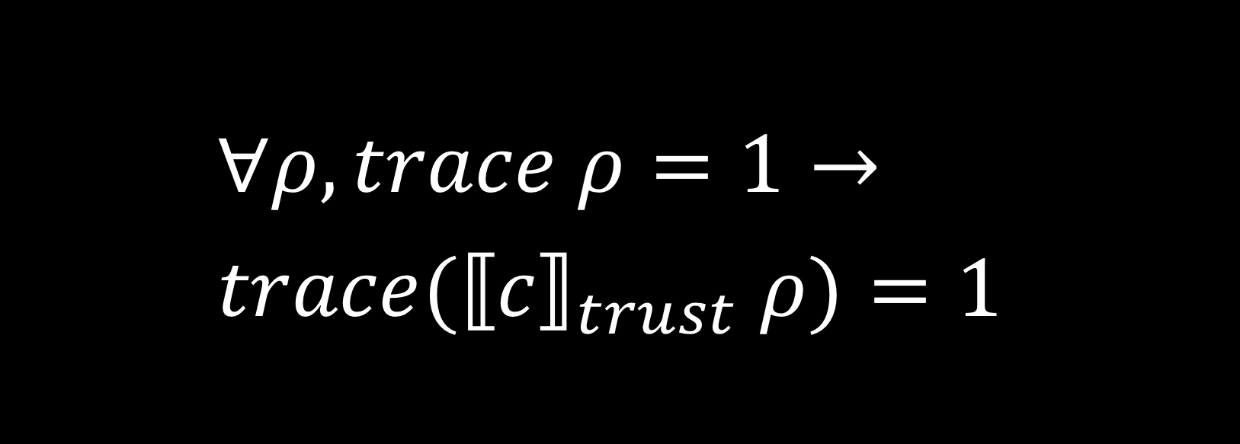
Trace-Preserving Safety
$$∀ρ, trace ρ=1→ \\ {trace(⟦c⟧}_{trust} ρ)=1$$

Slide 15
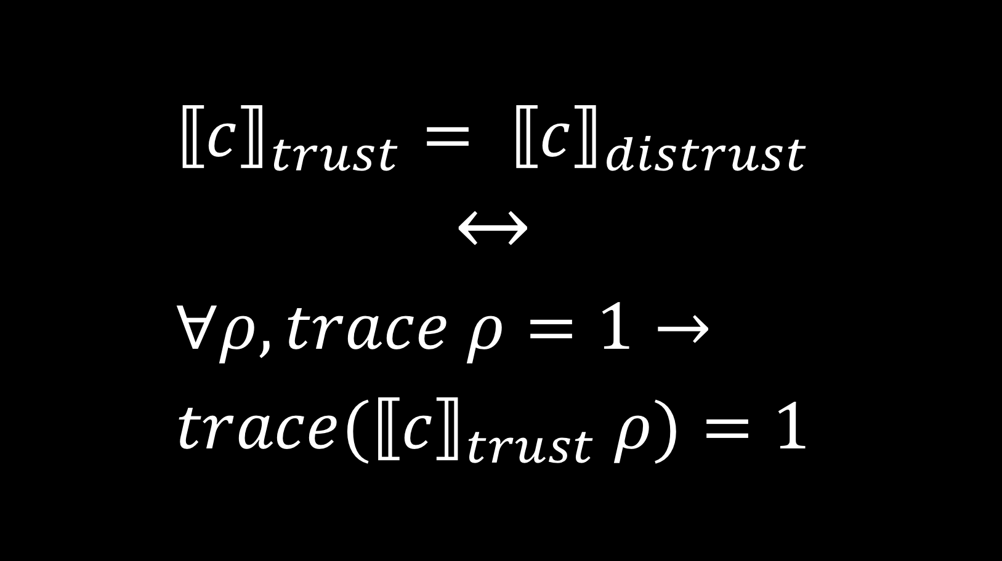

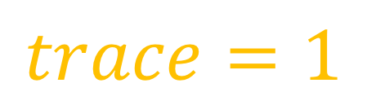
Trace-Preserving Safety
$${⟦c⟧}_{trust}= {⟦c⟧}_{distrust}$$
$$↔$$
$$∀ρ, trace ρ=1→ \\ {trace(⟦c⟧}_{trust} ρ)=1$$
$$trace=1$$
$$non−increasing$$
Notes:
Add proof!

Slide 16





Sufficient Syntax
Inverted Unitaries
Restricted Inverse [Amy et al 2017]
$$0$$
$U$
$U^{†}$
$$0$$
$$0$$
C
C⁻¹
$$0$$

Slide 17








Computing oracles
$$x$$
$b_{1}$
$b_{2}$
$b_{2}$
$b_{1}$
Definition compile (b : bexp) (qs, q) :=
| b1 & b2 => q1 <- init0;
q2 <- init0;
(qs,q1) <- compile b1 (qs,q1);
(qs,q2) <- compile b2 (qs,q2);
(q1,q2,q) <- CCNOT (q1,q2,q)
assert0 q2;
assert0 q1
$$y$$
$$0$$
$$0$$
$$0$$
$$0$$
$$q$$

Slide 18




Computing oracles
$$x$$
$b_{1}$
$b_{2}$
$b_{2}$
$b_{1}$
Lemma compile_types : forall b,
Well_Typed (compile b).
Lemma compile_safe : forall b,
Correct_Assertions (compile b).
Proof. apply symmetric_safe. Qed.
$$y$$
$$0$$
$$0$$
$$0$$
$$0$$
$$q$$

Slide 19











Computing oracles
$$f x$$
$b_{1}$
$b_{2}$
$b_{2}$
$b_{1}$
$$f x$$
Lemma compile_correct:
forall b q (f : var -> B),
⟦compile b⟧ (matrix f ⊗ q) =
matrix f ⊗ (q ⊕ ⟦ b f ⟧)
$$f y$$
$$f y$$
$$0$$
$$0$$
$$0$$
$$0$$
$$q$$
$$q⊕(fx∧fy)$$

Slide 20
Applications
Verified Optimization
$$0$$
$$0$$
$$0$$
$$0$$

Slide 21
Applications
Verified Optimization
Circuit Reversal
Verified Quantum Arithmetic
$$0$$
$$0$$

Slide 22
Assert: applause

